Slide 1

TecSo Internship Module
Prepared By :
Divyesh Parmar (D13IT137)
Chirag Shitole (D13IT138)
External Guide:
Ms. Komal Pathak
Internal Guide:
Prof. Jay Patel

Slide 2
Project Profile
Project Title : TecSo Internship Module
Project Description : This is an android application which will be used to handle details of interns who are interested in internship in the organization. It consists of all the details in brief of intern throughout the training period. .
Tools/Technology : Front End : Eclipse Luna
Back End : MySQL
Tools Used : Android SDK

Slide 3
Project Overview
Introduction:
The main objective to built this application is to handle all the basic as well as project details of intern who comes for internship.
The main purpose of this application is to provide portability to HR Manager.
HR Manager will manage all the details of intern and can view or update it through smartphone.
Intern can be able to view their account once registered.
After the completion of internship HR Manager can delete the record of that particular intern if he/she wants.

Slide 4
Project Overview [cont..]
Purpose:
To provide a mobility environment for organization’s HR.
Easily access from anywhere and any time.
Scope:
Scope of this application is up to integrated small circuit devices.
Scope of this application is only up to Android platform.
Objectives:
Details of intern will be accessible faster.
Details can be managed through any android device.
This application will reduce paper work.

Slide 5
Detailed Description of System
Existing System:
Existing system is a file based.
In this system records are managed and stored in the form of files.
Where it seems difficult to handle and manage these records.
Proposed System:
By implementing this application, it will remove file system.
Records will be managed and stored securely in the database.
Fast access and mobility will be provided to user.

Slide 6
Detailed Description of System[cont..]
Functional Requirements:
This system will record all the basic details of interns. The system will track intern’s progress report on constant time intervals. It will provide mobility environment to organization which will be beneficial for fast accessing the details of interns.
Non-Functional Requirements:
This application will access on android platform. There will be no redundancy in the database so memory will be used less. The database used is robust, reliable and fast so output will be displayed quickly.

Slide 7
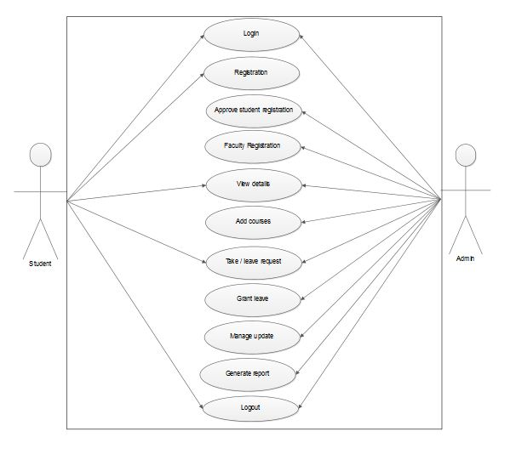
Diagrams
Use-Case Diagram:

Slide 8
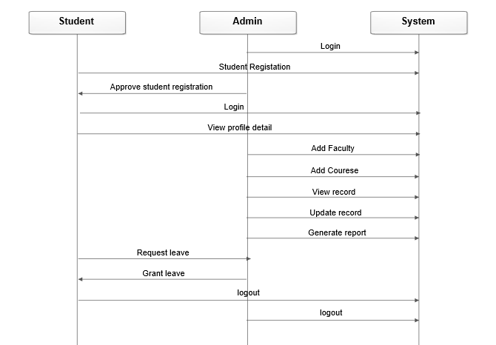
Sequence Diagram:

Slide 9
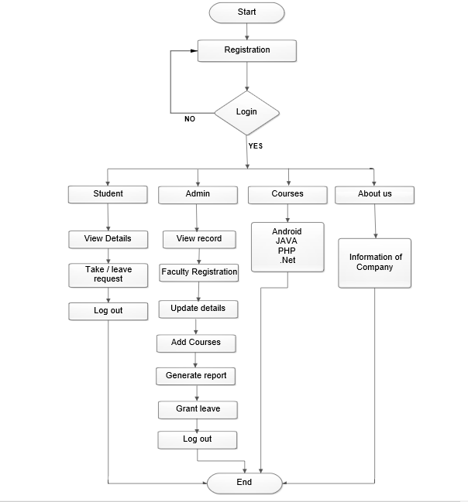
Flow Chart Diagram:

Slide 10
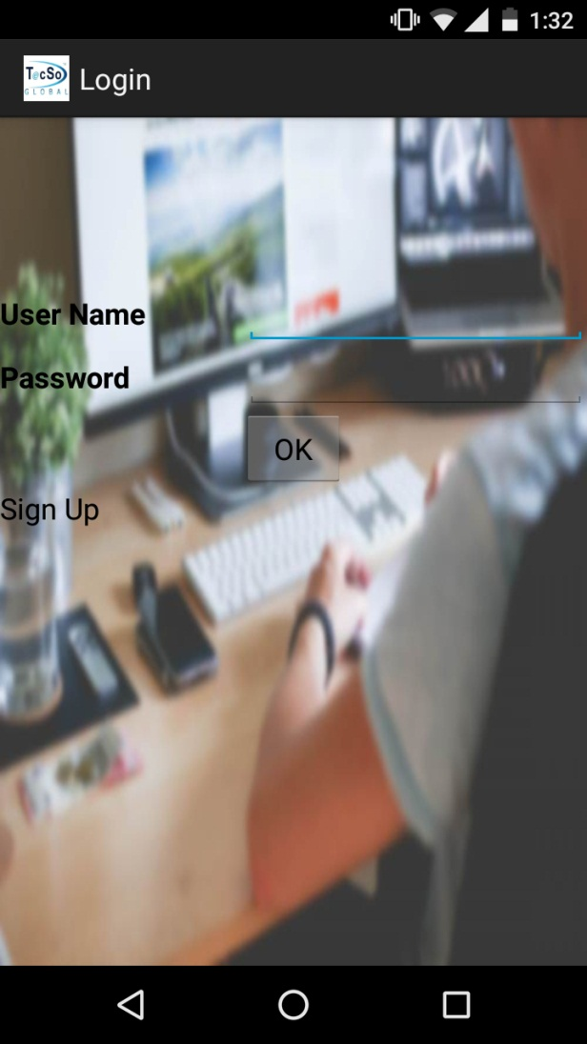
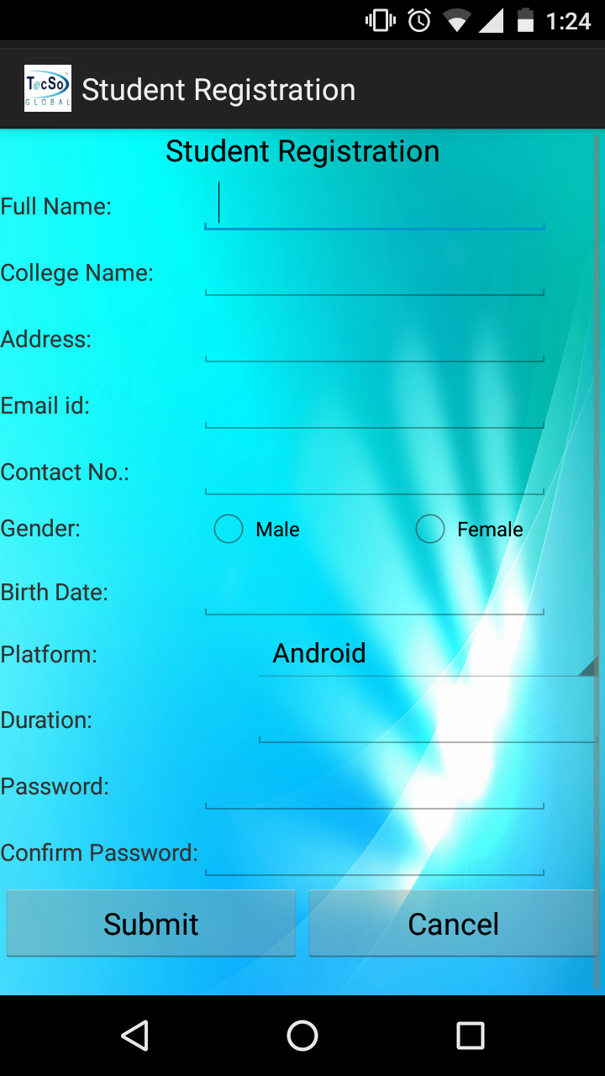
Screenshots
1.Login Page:
2.Student Registration Page:

Slide 11
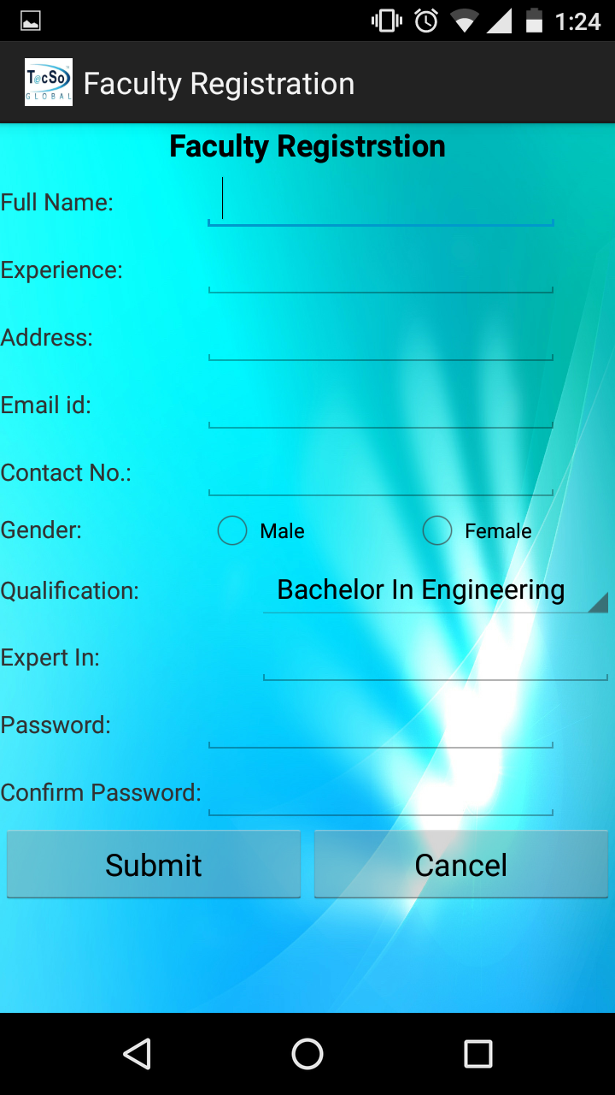
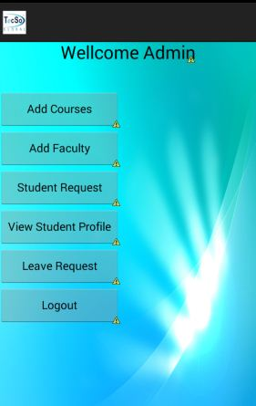
Screenshots [cont…]
3.Faculty Registration Page:
4. Admin:

Slide 12
Pros
Work can be done more faster.
Security will be achieved.
Paper work will be negligible.
Easy to manage data as it can be accessed through any android device.
Mobility will be achieved.
The application contains less memory which can be easily installed on android device.

Slide 13
Limitations
As it is an android application it can only be used on android devices.
Internet is required to use this application.
It is built for a specific organization so its use will be limited upto that organization and its employees.

Slide 14
Future Enhancement
As the organization works on three different departments which are energy, engineering and IT/CE, so in future this application would be implemented in these departments.
Weekly report can be send to intern as by e-mail.
Test domain may also be implemented.
In this application we have just designed a static registration page for intern in future we can scan intern photo to view.

Slide 15
Thank you !!

